Slide 1
Evalink
Sistema de Evaluación de Desempeño Compromiso de Avance – 26 de septiembre 2025
Equipo:
Vicente Farías
Sharay Muñoz
Sebasthian Silva

Slide 2
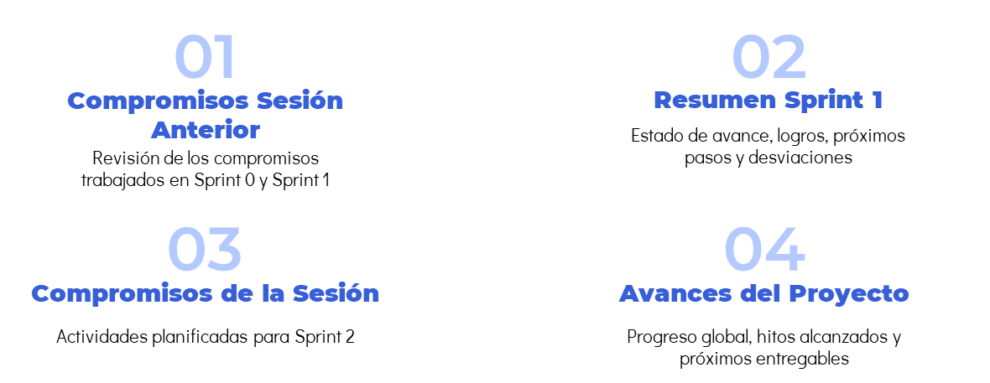
Agenda

Slide 3
Compromisos Sesión
ID | Actividad / Historia | Responsable | Sprint | Estado | Comentarios
26 | Diseño en figma de Login | SS | Sprint 1 | Listo | Interfaz gráfica completada y validada
30 | Creación de MER para usuarios | SM | Sprint 1 | Listo | Definición y validación completadas
28 | Gestión de Usuarios | VF | Sprint 1 | En curso | Desarrollo de CRUD en progreso
31 | Documento de Requerimientos (Parte 2) | SM | Sprint 1 | En revisión | Redacción de secciones pendientes
24 | Inicio de Sesión con Google | VF | Sprint 1 | Listo | Integración de autenticación completada

Slide 4
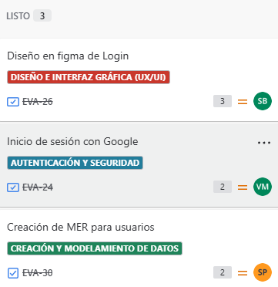
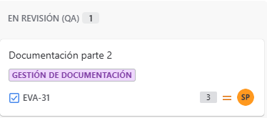
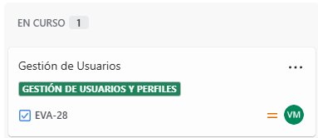
Resumen Sprint 1
Fecha Reporte |  |  | Explicación del Desvío
26/09 |  |  | 15% de atraso respecto al calendario. Es decir, deberíamos tener un 73%
Fecha inicio
16/09
Fecha Fin
30/09 |  |  | Próximos Hitos Claves
Estado Actual |  |  | Finalización Sprint 1: 30/09 Planificación Sprint 2: 01/10
Listo: 58%
QA: 25%
En curso: 33%
Estado: En Curso
Estado anterior (Sprint 0) | Temas Destacados |  | Temas Abierto
Avance Real: 100% | Logros Diseño de login en Figma completado y en revisión. Documento de requerimientos (Parte 2) avanzado. MER de usuarios creado y sometido a retroalimentación. | Próximos pasos Finalizar documentación de requerimientos. Validar y aprobar el diseño gráfico de la interfaz. Continuar desarrollo de gestión de usuarios e inicio de sesión con Google.
Avance Planificado: 100%
Desviación: 0%
Estado: Cerrado (Completado)

Slide 5
Próximos Compromisos de Sesión
ID | Actividad / Historia | Responsable | Sprint | Estado | Comentarios
26 | Mantener sesión activa | Equipo | Sprint 2 | Tareas por hacer | Requiere validación posterior al inicio de sesión con Google
30 | Diseño de plantillas | Equipo | Sprint 2 | Tareas por hacer | En espera de revisión de diseño inicial
28 | MER plantillas de evaluación | Equipo | Sprint 2 | Tareas por hacer | Definición de entidades lista, pendiente validación del equipo
31 | Plantilla de evaluación | Equipo | Sprint 2 | Tareas por hacer | Desarrollo inicial programado para esta semana

Slide 6
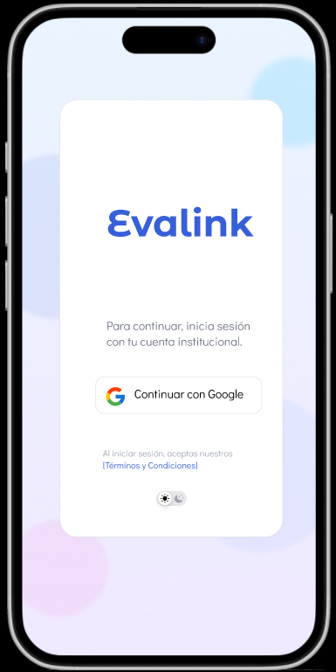
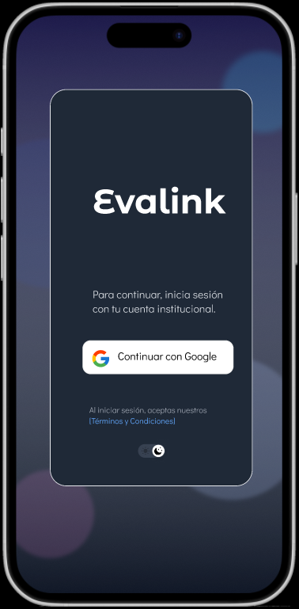
Avances – Diseño de Interfaz (Login)
✅ Pantallas de inicio de sesión diseñadas en Figma (modo claro y oscuro).

Slide 7
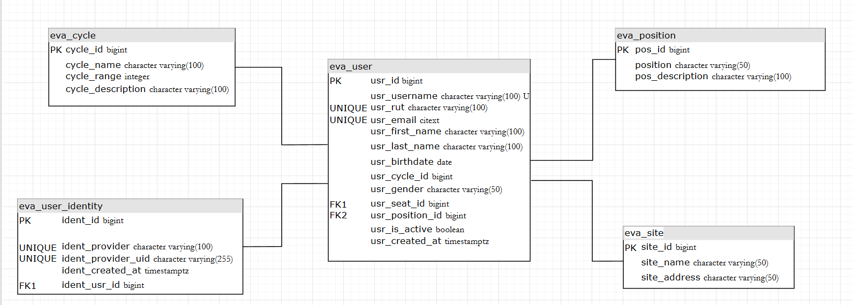
Avances – MER Usuarios Evalink
Se presentan las principales entidades con sus respectivos atributos.

Slide 8
Avances – Documentación parte 2
Se adapta matriz de traza de requisitos para la metodología Scrum.
Trazabilidad de requisitos

Slide 9
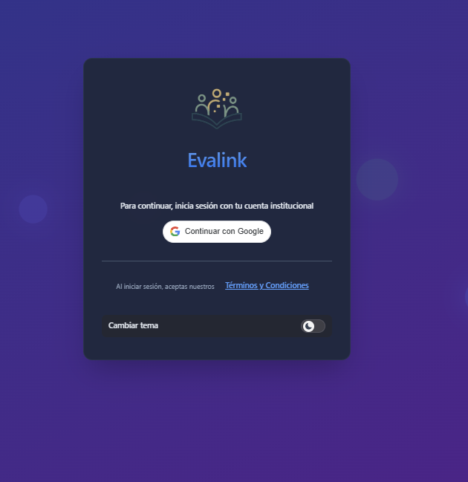
Avances – Inicio de sesión con google
Se Creó el id de cliente de OAuth 2.0 para trabajar en local como app web

Slide 10
Muchas Gracias!

Slide 11

A picture is worth a thousand words

Slide 12
Our history
19XX
19XX
2XXX
Today
Earth is the only one that harbors life in the Solar System
Despite being red, Mars is actually a very cold place
Jupiter is the biggest planet in the entire Solar System
Saturn is a gas giant and has several rings around itself

Slide 13
What sets us apart?
Neptune
The Sun
Pluto
Neptune is the farthest planet from the Sun
The Sun is the star at the center of the Solar System
Pluto is now considered a dwarf planet

Slide 14
Guiding principles
Mission
Vision
Mercury is the smallest one in the Solar System
Venus is the second planet from the Sun

Slide 15
- Someone Famous
“This is a quote, words full of wisdom that someone important said and can make the reader get inspired.”

Slide 16
02
Market analysis
You can enter a subtitle here if you need it

Slide 17
Audience demographics
Age
Interests
15-25: 35%
26-35: 65%
Gender
Mercury is the closest planet to the Sun and the smallest one in the Solar System
Female 56%
Male
30%
Other
14%
Reading 40%
Cooking 10%
Movies
20%
Music 30%

Slide 18
Top social networking sites
15%
35%
50%
Instagram
YouTube
TikTok

Slide 19
Buyer persona
Mailing she usually receives
Helena Smith
Mercury
Venus
Earth
Mars
Age: 25
Gender: female
Studies: Advertising
Location: Puerto Rico
Job: Publicist
Income range: $2000
Marital status: married
Hobbies: board games
Most recent interests
Jupiter
Saturn
Neptune
Pluto

Slide 20
Analyzing the competition
 | Logo | Name | Likes | Posts | Followers | Engagement
1 |  | Company 1 | 2.5M | 300 | 950K | 75%
2 |  | Company 2 | 6.3M | 590 | 686K | 50%
3 |  | Company 3 | 5.6M | 130 | 523K | 25%
4 |  | Company 4 | 6.8M | 690 | 210K | 15%
5 |  | Company 5 | 1.4M | 780 | 53K | 05%

Slide 21
03
Goals & strategy
You can enter a subtitle here if you need it

Slide 22
Our goals
Goal #1
Goal #2
Goal #3
Goal #4
Goal #5
Goal #6
Mercury is the closest planet to the Sun
Venus is the second planet from the Sun
Earth is the third planet from the Sun
Despite being red, Mars is actually a cold place
Jupiter is the biggest planet in the System
Saturn is a gas giant and has several rings

Slide 23
Our strategy
Mother brand
The Sun is the star at the center of the Solar System
Media A
Media B
Media C
Jupiter is the biggest planet in the System
Saturn is a gas giant and has several rings
Neptune is actually a far away planet
Outcome A
Outcome B
The Sun is the star at the center of all
The Moon is Earth’s only natural satellite

Slide 24
Awesome words

Slide 25
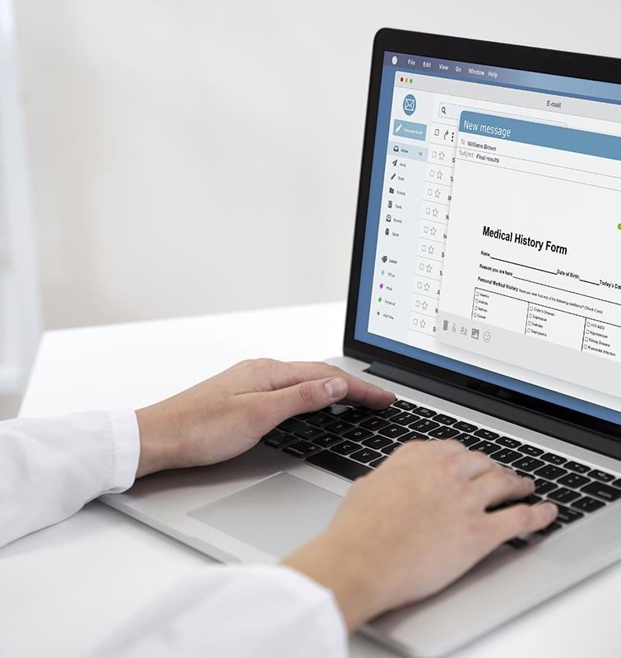
A picture reinforces the concept
Images reveal large amounts of data, so remember: use an image instead of a long text. Your audience will appreciate it

Slide 26
04
Content plan
You can enter a subtitle here if you need it

Slide 27
Our areas of expertise
Area A
Promote social media
Mercury is the closest planet to the Sun and the smallest one in the Solar System
Area B
Public awareness
Venus has a beautiful name and is the second planet from the Sun
Area C
Encourage donation
Earth is the only one that harbors life in the Solar System

Slide 28
What content are we going to create?
Mars
Jupiter
Saturn
Neptune
Despite being red, Mars is actually a cold place
Jupiter is a gas giant and the biggest planet in the System
Saturn is a gas giant and has several rings
Neptune is the farthest planet from the Sun

Slide 29
What content are we going to use?
Do you know what helps you make your point clear?
Lists like this one:
They’re simple
You can organize your ideas clearly
You’ll never forget to buy milk!
And the most important thing: the audience won’t miss the point of your presentation

Slide 30
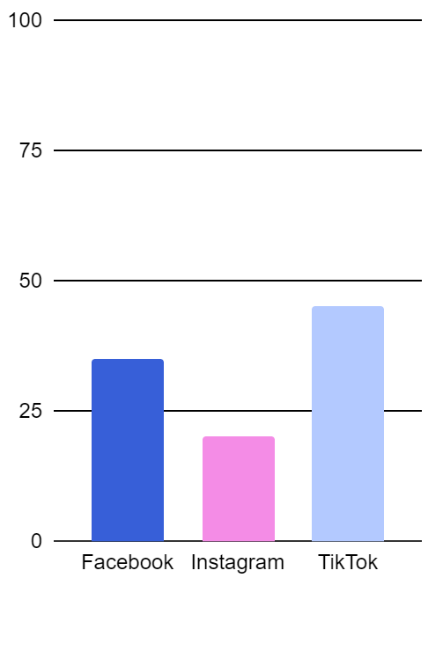
What platforms are we going to use?
 | Facebook | Instagram | TikTok
Goal | Write your text in here | Write your text in here | Write your text in here
Objectives | Write your text in here | Write your text in here | Write your text in here
Audiences | Write your text in here | Write your text in here | Write your text in here
Measurement | Write your text in here | Write your text in here | Write your text in here
Follow the link in the graph to modify its data and then paste the new one here. For more info, click here

Slide 31
Content sharing plan
Social network | Content | Day | Time
Facebook | Mercury | Monday | 10:30 AM
Instagram | Venus | Saturday | 12:30 PM
TikTok | Earth | Sunday | 10:40 PM
LinkedIn | Mars | Everyday | 05:25 PM
YouTube | Jupiter | Friday | 03:35 PM

Slide 32
Calendar
Sun | Mon | Tue | Wed | Thu | Fri | Sat
 |  | 1 | 2 | 3 | 4 | 5
6 | 7 | 8 | 9 | 10 | 11 | 12
13 | 14 | 15 | 16 | 17 | 18 | 19
20 | 21 | 22 | 23 | 24 | 25 | 26
27 | 28 | 29 | 30 | 31
IG: Post #1
IG: Post #2
TikTok: Post #1
FB: Post #1
TikTok: Post #2
FB: Post #2
TikTok: Post #3
FB: Post #3
TikTok: Post #4

Slide 33
05
Budget
You can enter a subtitle here if you need it

Slide 34
Our budget
$100k
$25K
$250k
$500
For TikTok
For Instagram
For Facebook
For Linkedin

Slide 35
150,000
Big numbers catch your audience’s attention

Slide 36

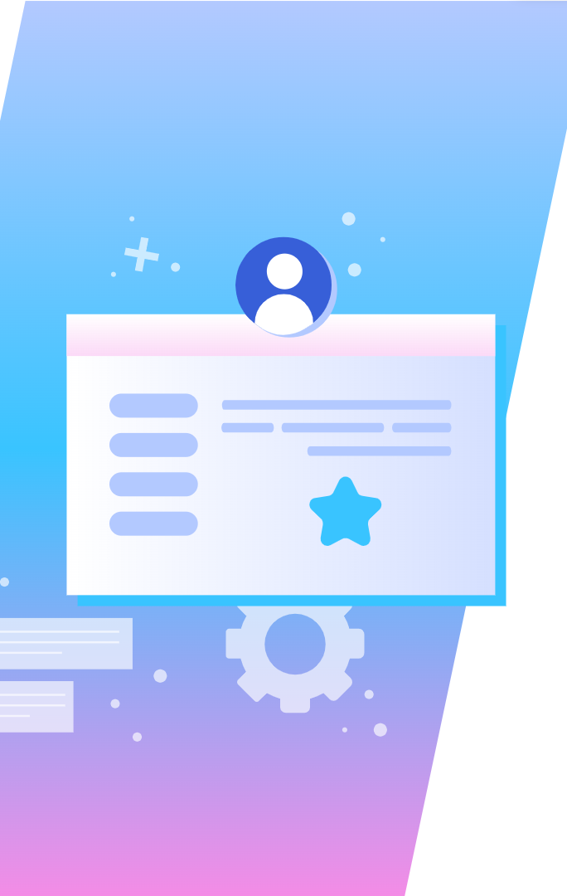
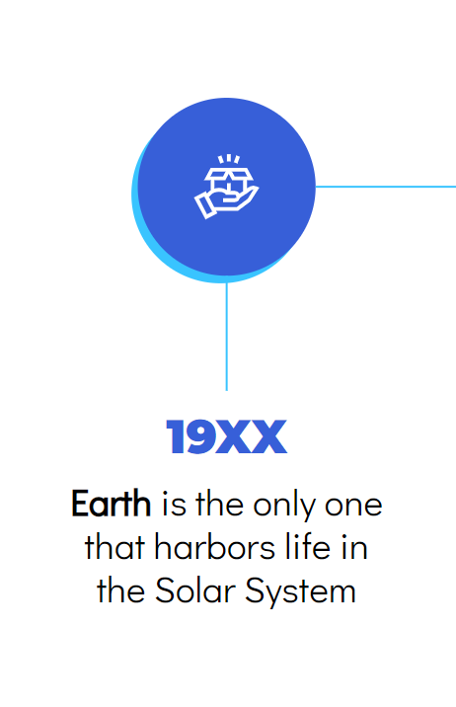
Mockup devices
You can replace the image on the screen with your own work. Just right-click on it and select “Replace image”

Slide 37
06
KPI overview
You can enter a subtitle here if you need it

Slide 38
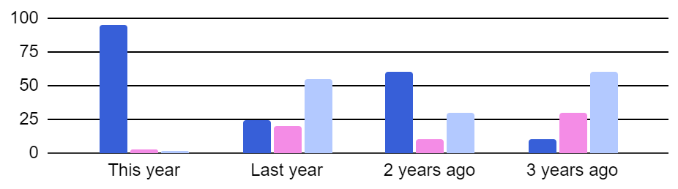
KPI overview
Social media engagement
Followers: 5,408
Followers: 1,208
Views & likes: 408
Connect: 400
Followers: 5,000
Product A
Product B
Product C
Follow the link in the graph to modify its data and then paste the new one here. For more info, click here

Slide 39
Where will we communicate?
America
Neptune is the farthest planet from the Sun
Asia
The Sun is the star at the center of all

Slide 40
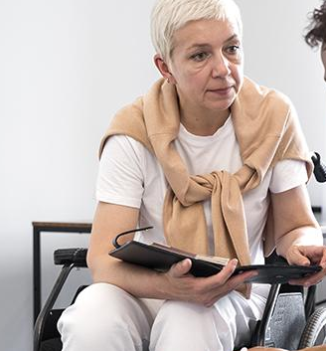

Our team
Sage Alvarado
Ganesh Fujin
You can speak a bit about this person here
You can speak a bit about this person here

Slide 41
Thanks!
Does anyone have any questions?
addyouremail@freepik.com
+91 620 421 838
yourcompany.com
Please keep this slide as attribution

Slide 42
Icon pack

Slide 43
Alternative resources
Here’s an assortment of alternative resources whose style fits the one of this template:
Modern web banners with flat design

Slide 44
Resources
Did you like the resources of this template? Get them for free at our other websites! Photos:
Crop man using computer keyboard
Doctor writing about routine medical checkup
Medium shot black man at work
Full shot woman in wheelchair at work
Vectors:
Gradient effect landing page
Modern web banners with flat design
Icons:
Icon Pack: Marketing & SEO | Lineal

Slide 45
Instructions for use
If you have a free account, in order to use this template, you must credit Slidesgo by keeping the Thanks slide. Please refer to the next slide to read the instructions for premium users.
As a Free user, you are allowed to:
Modify this template.
Use it for both personal and commercial projects.
You are not allowed to:
Sublicense, sell or rent any of Slidesgo Content (or a modified version of Slidesgo Content).
Distribute Slidesgo Content unless it has been expressly authorized by Slidesgo.
Include Slidesgo Content in an online or offline database or file.
Offer Slidesgo templates (or modified versions of Slidesgo templates) for download.
Acquire the copyright of Slidesgo Content.
For more information about editing slides, please read our FAQs or visit our blog:
https://slidesgo.com/faqs and https://slidesgo.com/slidesgo-school

Slide 46
Instructions for use (premium users)
As a Premium user, you can use this template without attributing Slidesgo or keeping the "Thanks" slide.
You are allowed to:
Modify this template.
Use it for both personal and commercial purposes.
Hide or delete the “Thanks” slide and the mention to Slidesgo in the credits.
Share this template in an editable format with people who are not part of your team.
You are not allowed to:
Sublicense, sell or rent this Slidesgo Template (or a modified version of this Slidesgo Template).
Distribute this Slidesgo Template (or a modified version of this Slidesgo Template) or include it in a database or in any other product or service that offers downloadable images, icons or presentations that may be subject to distribution or resale.
Use any of the elements that are part of this Slidesgo Template in an isolated and separated way from this Template.
Register any of the elements that are part of this template as a trademark or logo, or register it as a work in an intellectual property registry or similar.
For more information about editing slides, please read our FAQs or visit our blog:
https://slidesgo.com/faqs and https://slidesgo.com/slidesgo-school

Slide 47
Fonts & colors used
This presentation has been made using the following fonts:
Montserrat
(https://fonts.google.com/specimen/Montserrat)
Didact Gothic
(https://fonts.google.com/specimen/Didact+Gothic)
#000000
#375fd8
#ffffff
#f48ce6
#39c4ff
#b3c9ff

Slide 48





Storyset
Create your Story with our illustrated concepts. Choose the style you like the most, edit its colors, pick the background and layers you want to show and bring them to life with the animator panel! It will boost your presentation. Check out how it works.
Pana
Amico
Bro
Rafiki
Cuate

Slide 49
Use our editable graphic resources...
You can easily resize these resources without losing quality. To change the color, just ungroup the resource and click on the object you want to change. Then, click on the paint bucket and select the color you want. Group the resource again when you’re done. You can also look for more infographics on Slidesgo.

Slide 52
JANUARY
FEBRUARY
MARCH
APRIL
MAY
JUNE
PHASE 1
Task 1
Task 2
PHASE 2
Task 1
Task 2
JANUARY
FEBRUARY
MARCH
APRIL
PHASE 1
Task 1
Task 2

Slide 55
...and our sets of editable icons
You can resize these icons without losing quality.
You can change the stroke and fill color; just select the icon and click on the paint bucket/pen.
In Google Slides, you can also use Flaticon’s extension, allowing you to customize and add even more icons.

Slide 56
Educational Icons
Medical Icons

Slide 57
Business Icons
Teamwork Icons

Slide 58
Help & Support Icons
Avatar Icons

Slide 59
Creative Process Icons
Performing Arts Icons

Slide 60
Nature Icons

Slide 61
SEO & Marketing Icons

Slide 62


